Slide 1
Lewis Dot Diagrams

Slide 2
LEWIS DOT DIAGRAMS
Find the valence electrons.
Write the element symbol.
Draw the dots starting at the top right of the symbol.

Slide 3
EXAMPLE – Carbon (Element #6)
Find the valence electrons.
Write the element symbol.
Draw the dots starting at the top of the symbol and continuing clockwise.
Carbon has 4 valence electrons because it is in group 14.
Element symbol is C.
1
C
4
2
3
Pretend like there’s an imaginary box around the letters

Slide 4
EXAMPLE – Sulfur (Element #16)
Find the valence electrons.
Write the element symbol.
Draw the dots starting at the top right of the symbol and continuing clockwise.
Sulfur has 6 valence electrons because it is in group 16.
Element symbol is S.
1
5
S
2
4
6
3

Slide 5
OTHER EXAMPLES
B
Cu
Bromine has seven valence electrons because it’s in Group Seventeen
Copper has one or two valence electrons because it’s a transition metal
Boron has three valence electrons because it’s in Group Thirteen
Br

Slide 6
FOR YOU TO TRY…
How many valence electrons does tin have?
Kr
Ca
4 because it’s in Group Fourteen
How many valence electrons does Krypton have?
How many valence electrons does calcium have?
Sn
8 because it’s in Group Eighteen
2 because it’s in Group Two

Slide 7
Classwork
Draw the Lewis Dot Diagrams for neutral atoms of the following elements:
  F
  Al
  Si
  K
  Mg
  N
  O

Slide 8

Lewis Structures
Lewis

Slide 9
Lewis Structures
A Lewis structure is a two-dimensional representation of a molecule
Lewis structures have a systematic method used to determine how they should be written

Slide 10
Ionic Compounds
Vs
Covalent
(Molecules) Compounds

Slide 11
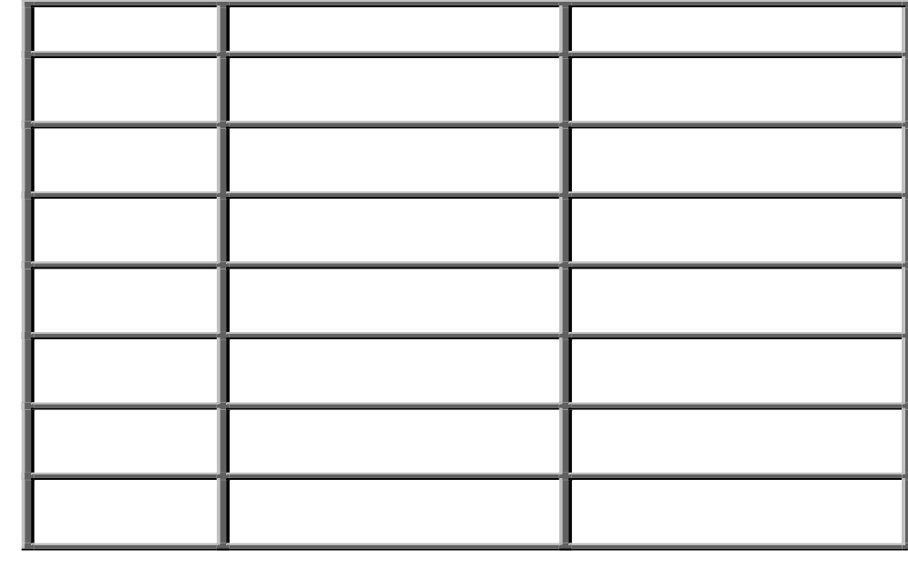
B. Types of Bonds
IONIC
COVALENT
Bond Formation
e⁻ are transferred from metal to nonmetal
e⁻ are shared between two nonmetals
Type of Structure
crystal lattice
true molecules
Physical
State
liquid or gas
solid
Melting
Point
high
low
Solubility in
Water
yes
usually not
Electrical Conductivity
yes (solution or liquid)
no
Other
Properties
odorous

Slide 12

B. Types of Bonds
METALLIC
Bond Formation
e⁻ are delocalized among metal atoms
Type of Structure
“electron sea”
Physical
State
solid
Melting
Point
very high
Solubility in
Water
no
Electrical Conductivity
yes (any form)
Other
Properties
malleable, ductile, lustrous

Slide 13

Rules for writing ionic compound Lewis structures
Determine that a metal is present / first
element on left of periodic table(Not counting H).
Write the Lewis structures for the elements in
the ionic compound.
Draw an arrow showing the transfer of the
electrons from the metal (low electronegativity
element) to the non-metal (high electronegativity.)

Slide 14
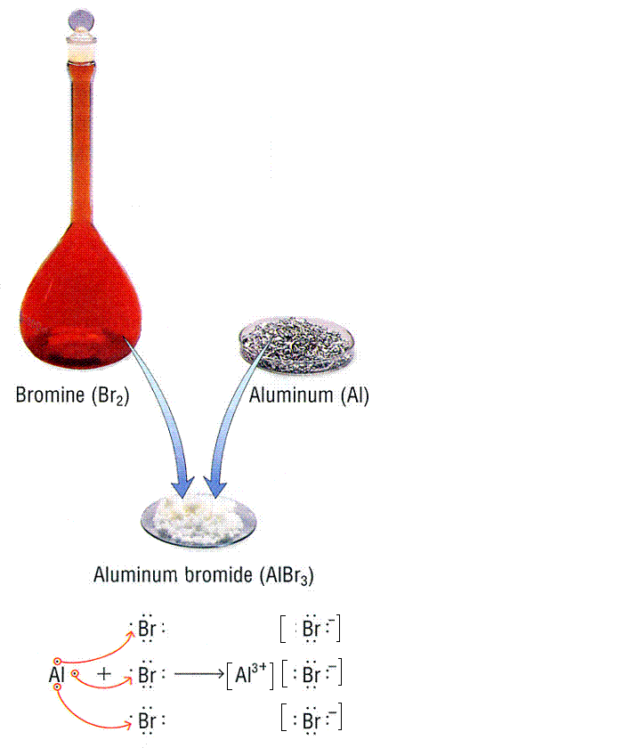
Ionic Compounds

Slide 15
Lewis Structures
Sum the valence electrons from each atom
  Valence electrons can be found from group number
Use a pair of electrons to form a bond between each pair of bound atoms
Arrange the remaining electrons to place 2 electrons around period 1 elements and 8 electrons around other period elements
Resonance: when multiple Lewis structures exist for the same compound

Slide 16
Practice
PCl₃
NI₃
NO⁺
SCN⁻ (C is the central atom)
HCl
ClF
Br₂
H₂O
O₂

Slide 17
More Examples
NH₄⁺
CO₂
CN⁻
Cl₂
HCN
ClO₃–

Slide 18
Homework
HF
N₂
NH₃
CH₄
CF₄
NO⁺
NO₃⁻

Slide 19
Lewis Structures - Exceptions
Octet rules fails
  Molecules with an odd number of electrons
  Examples: ClO₂
  Molecules in which an atom has less than an octet
  Example: BF₃
  Molecules in which atom has more than an octet
    Example: PCl₅
  Practice
  Draw the Lewis structure for ICl₄–

Slide 20
Practice
Draw the Lewis Structures for the following compounds:
  I₂
  SiO₂
  ClF₃
  XeO₃
  RnCl₂
  BeCl₂

Slide 21
Resonance
A resonance structure is one of two or more Lewis structures that have the same skeletal formula, but different electron arrangements.
The actual structure of the molecule is the intermediate between the two or more resonance structures and is called a resonance hybrid.

Slide 22
Resonance
Draw the Lewis structure for O₃ and include all possible resonance structures.

