Slide 1
Surviving Chemistry 7 and 8
Required to check www.chemdoctor.org everyday. Click: Chemistry 8 (2019-2020) or Chemistry 7 (2019-2020).
Watch ChemDoctor Videos when assigned
Read the packets and work ALL the sample problems
Do the follow-up after white boarding
Recopy notes, review the packets, practice problems
Understand the Labs
Use the student hours

Slide 2
Surviving Chemistry 7and 8
Grading Policy
Exams, Practical Exams, Final Graded Lab 20%
Quizzes, Graded Labs 80%
Exams: Five day warning—usually more
Quizzes and graded labs can be unannounced
Subjective grade as part of each trimester

Slide 3
Supply List
1 box (dry-erase) markers
1 whiteboard eraser
One section in your 3-ring binder dedicated to chemistry or a single dedicated notebook
1 pair safety glasses-get cool ones
TI calculator—not allowed to use the Ti Inspire
Pen, pencil, eraser
Baggy T-shirt that can be worn over nice clothes for lab.

Slide 4
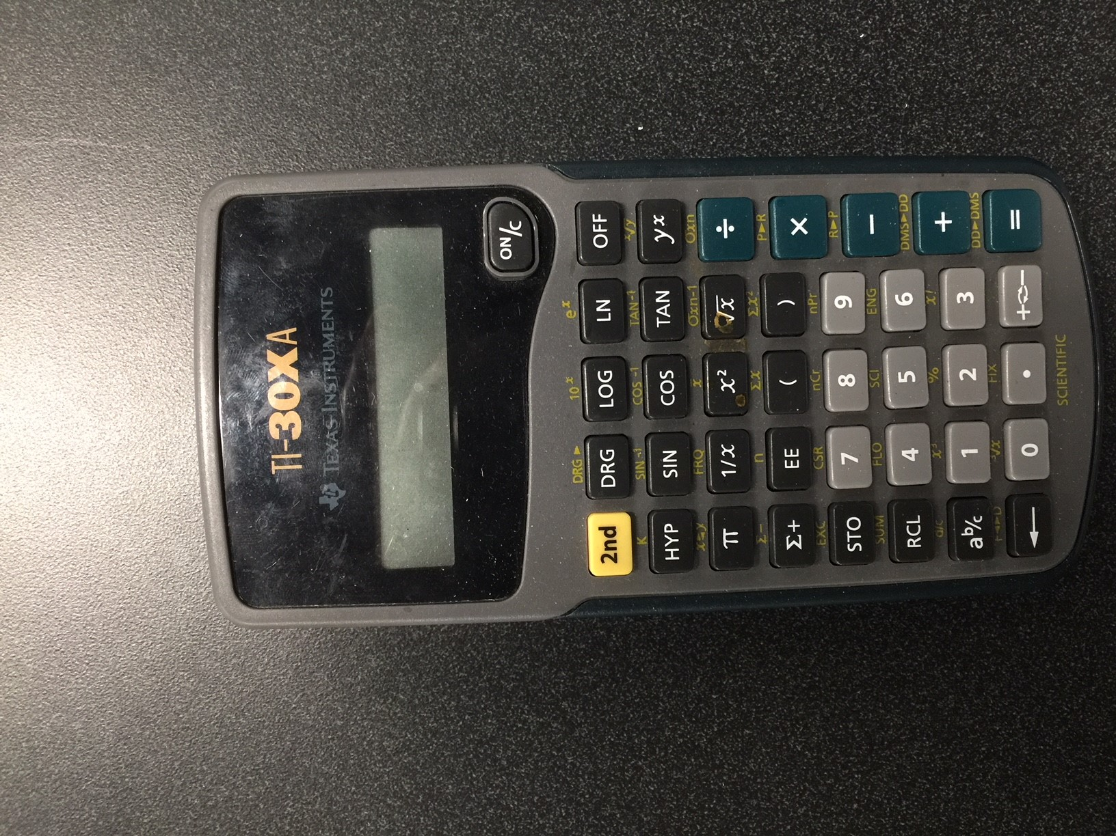
Calculator Option

Slide 5
Surviving Chemistry 7and 8
Entering the Room: Sit quietly and complete CJ and Bell Work in notebook or complete any directions given.
Do not handle or touch any lab gear
Fire Drills
Lock Down
Tutoring Hours
  8th grade Monday; 3:40 p.m.

Slide 6
Instructional Materials
www.chemdoctor.org (Chemistry 7 (2019-2020)) or (Chemistry 8 (2019-2020))
Teacher notes, concept packets, white boards, etc. found at website under Chemistry 8 (2019-2020).

Slide 7
Reasons for Low Grades
Disorganization
Failure to complete video work prior to lessons or labs
Cheating the white boards
No follow-up on the white boards
Taking good notes in lessons and in labs
Mastering lab techniques
Studying at the last minute

