Slide 1
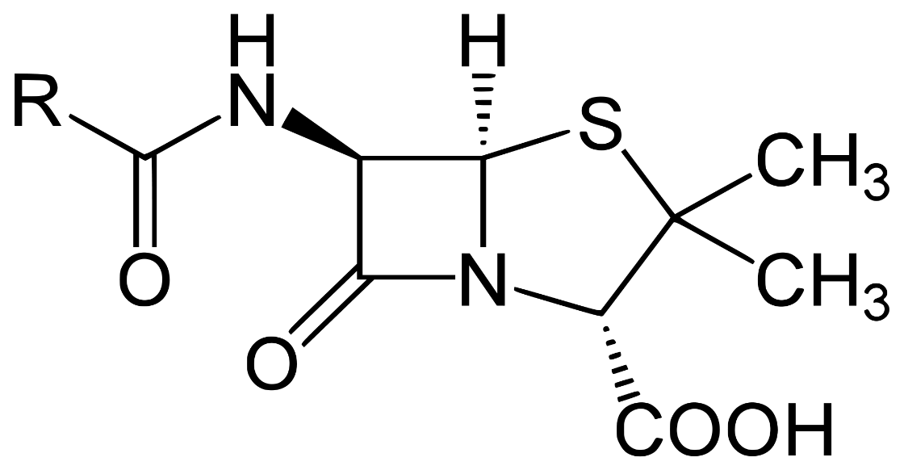
Organic Chemistry
The study of compounds that contain carbon.
Penicillin

Slide 2
Structure Determines Reactivity
Lewis Formulas
Placement of partial charges
3-D shape (geometry)
Acid/Base chemistry
Mechanism (step-by-step depiction of reaction)
Kinetics (rate limiting transition state)
Thermodynamics (ΔΗ, ΔS , ΔG)

Slide 3
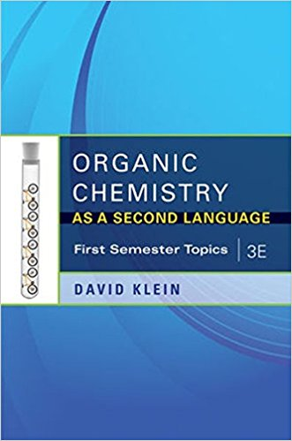
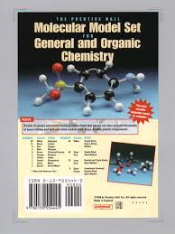
The Things You Need
Textbook: Organic Chemistry; As A Second Language by David Klein

Slide 4
Supplies
Dedicated Notebook Lecture Notes
Dedicated Lab Notebook
Textbook
Model Kit
Safety Glasses
White Board Markers
Scientific Calculator

Slide 5
Assessments
Tests
Quizzes
Graded Labs
Notebook Checks
Subjective Evaluation

