Slide 1
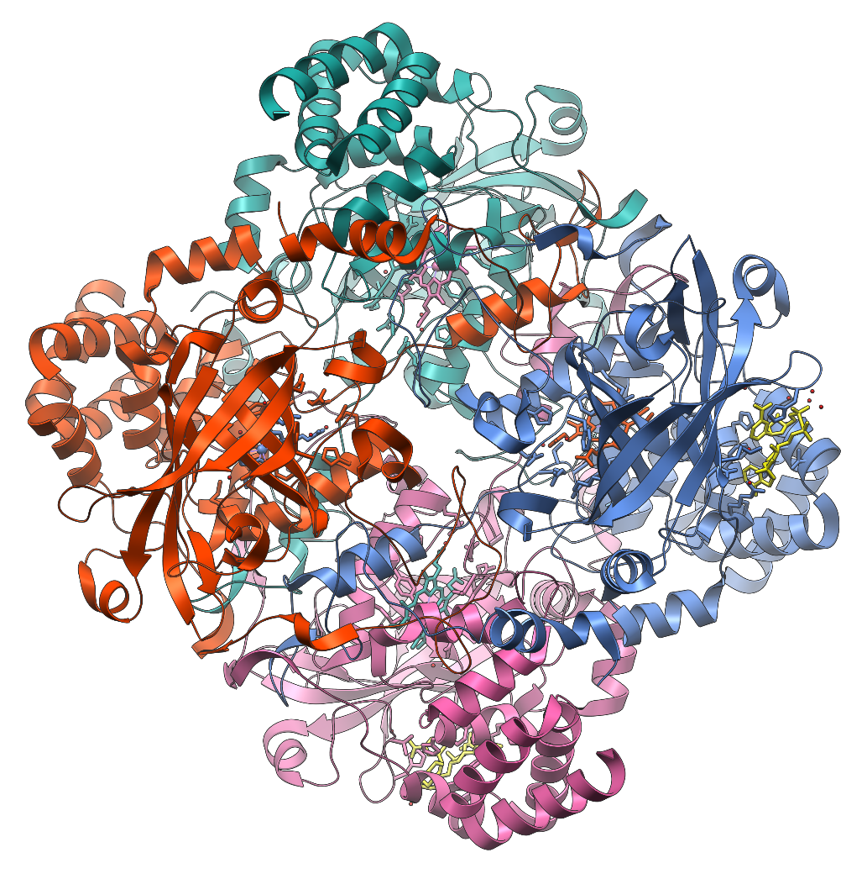
Catalase
(250kDa; Four 60kDa subunits)

Slide 2
Structure and Function
Protects cell from oxidative damage by hydrogen peroxide, H₂O₂
Catalase is found in plants and animals
Catalyzes:
2H₂O₂ H₂O + O₂

Slide 3
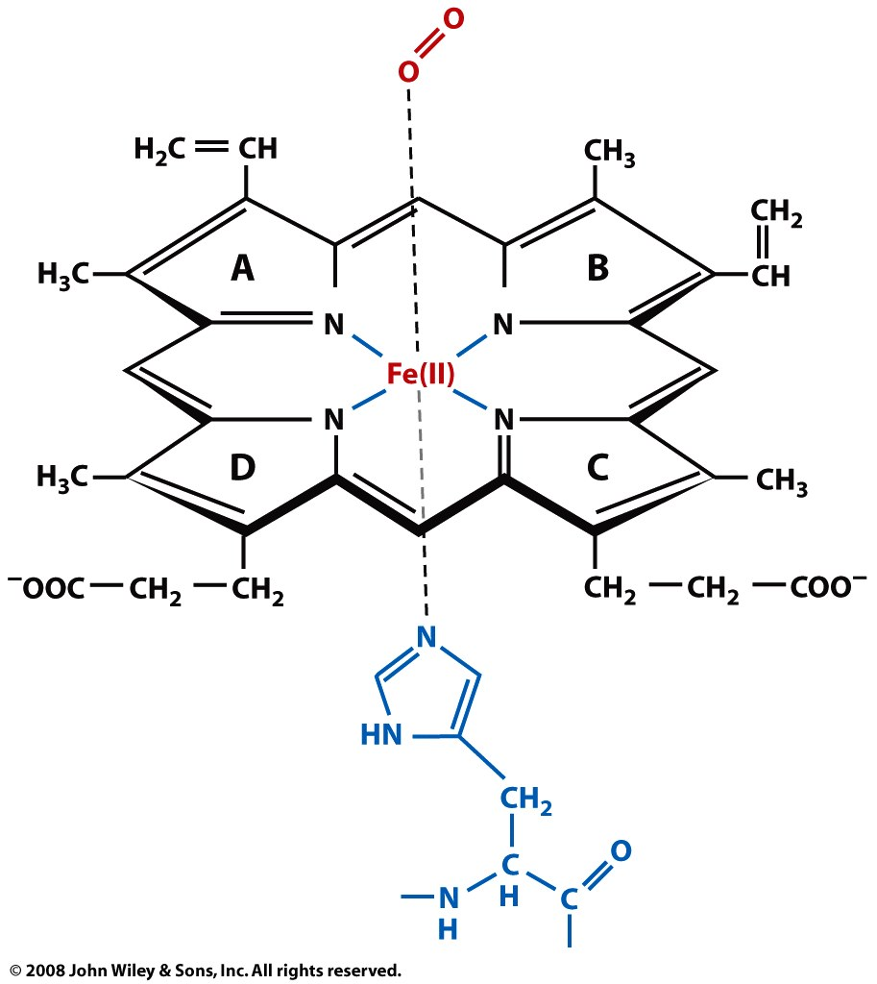
Porphyrin Heme

Slide 4
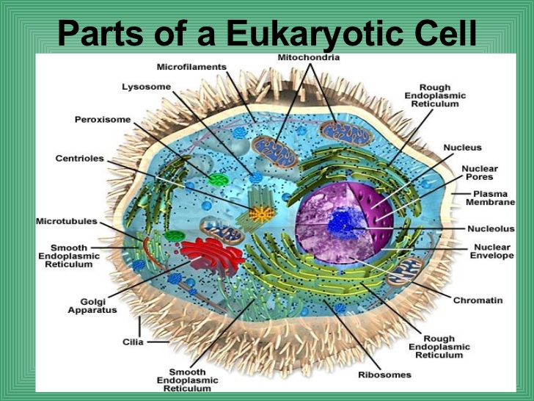
Cellular Locations of Catalase
Mitochondria
Lysosome
Peroxisome
Endoplasmic reticulum
Golgi Apparatus
Cytosol
Plasma Membrane

Slide 5
Catalase Capstone Goals
Master Basic Protein Biochemistry
  Solutions and Buffers
  Accurate Pipetting
  Use of Spectrophotometers: UV-vis HP 8452A Research Grade Instrument
  Bradford Assays and Protein Determination
  Catalase Enzyme Assay: Colorimetric and A₂₄₀
  Cell Free Extract
  Application of Techniques: Determination of Catalase Activity in Five Tissue Sources

Slide 6
Catalase Grading
Bench Marks: Pipetting, Bradford Assay, Colorimetric Enzyme Assays, Crude Cell Extracts, etc.
Cannot move ahead until passing benchmark. Cannot earn A without passing benchmark. Two grades; either A or B, that’s 100 or 85.
Supplies: Dedicated Lab Notebook
Final grade in T2:
    Benchmarks
    Subjective Evaluation
    Presentation

