Slide 1
Determination of Catalase Activity and its Inhibition by Triton X-100
By: Rohini Nott, Kinza Ahmed, Shabab Siddique, Afra Nawar

Slide 2
Two parts to the experiment

Slide 3
Determining Catalase Activity in 5 tissue samples
1

Slide 4
Using Triton X-100 as an inhibitor
2

Slide 5
Introduction
S

Slide 6
Discovery of Catalase
Louis Jacques Thenard
  Discovered hydrogen peroxide
  Suspected existence of catalase (1818)
    Thought breakdown of hydrogen peroxide caused by substance
Agricultural chemist Oscar Loew (1900)
  Conducted research on impact of calcium and magnesium on plant development
    Discovered and named the enzyme catalase
  Extracted catalase from the leaf extract of a tobacco plant, which decomposed H₂O₂
Notes:
Louis Jacques Thenard was the first to notice the existence of catalase in 1818. He discovered hydrogen peroxide and thought that the breakdown was caused by some substance.
In 1900, agricultural chemist Oscar Loew was conducting research on the impact of calcium and magnesium on plant development when he discovered and named the enzyme catalase. He extracted catalase from the leaf extract of a tobacco plant, which decomposed H2O2.

Slide 7
Experimentation with Catalase
Charles Appleman
  Attempt to correlate catalase activity
  Worked with potatoes
    Found a correlation between catalase activity and respiration.
    However, his work later showed that his method was inaccurate.
Crocker and Harrington
  Worked with Johnson grass seeds
    Established a correlation between catalase activity and respiration

Slide 8
Experimentation with Catalase
James B. Sumner
  Successfully crystallized catalase from beef liver (1937)
  Discovered the molecular weight (1938)
Discovery of amino acid sequence of bovine catalase (1969)
Discovery of 3D structure of catalase (1981)

Slide 9
Catalase Function
Hydrogen peroxide is produced as a byproduct
  Cytotoxic agent
    Must be eliminated from the body rapidly
    Build-up of H2O2 has harmful effect on body (including death)
Peroxisomes
  Organelle that produces H2O2
Catalase
  Enzyme
  Breaks down hydrogen peroxide into water and oxygen

Slide 10
Catalase Function (cont.)
3D structure has channel through which H2O2 diffuses
  The channel contains a heme group
    Heme group is a cofactor
    Fe3⁺, bound to the center of a porphyrin ring, a ring-like structure
H2O2 binds to the heme group, oxidizing it to Fe4⁺
Catalase reverts back to Fe3⁺ and reduces H2O2 to H2O
Fe4⁺ reacts with H2O2
  Releases both H2O and O2
Notes:
http://scienceline.ucsb.edu/getkey.php?key=166

Slide 11
Size (Molar Mass)
Globular (water-soluble) shape
Many species of catalase are tetramers of 60,000 dalton subunits
  Each tetramer is made up of 4 heme groups
  R groups on the surface of tetramer are hydrophilic and polar
Catalase has tetramer with molecular weight of 240,000
Bovine and human catalase were discovered to contain 4 tightly bound molecules of NADPH
  Not required for catalase activity
  Decreases susceptibility of catalase to inactivation (when exposed to low levels of H2O2)

Slide 12
Catalase Primary Structure
506-amino acid polypeptide chain
Heme group
NADH molecule

Slide 13
Catalase Secondary Structure
Alpha helixes
  26%
Beta pleated sheets
  12%
Many extended single strands and loops
  Help assemble the tetramer
Notes:
60% made up of regular secondary structure motifs, which describe the connectivity between secondary structural elements.

Slide 14
Catalase Tertiary Structure
Each monomer has 4 domains.
Made up of amino terminal 75 residues
Contains moiety heme. Has a beta barrel, helical segments, and several loops.
  Beta barrel: twisted and folded beta sheet into a closed structure in which the 1st and last strands are hydrogen bonded together.
Wrapping domain (contains only 2 discernable helices)
Folded into a 4-helical domain. Forms one surface of catalase

Slide 15
Catalase Quaternary Structure
Made up of a tetramer of 4 subunits
Each monomer has one heme and NADP
  NADP are on the surface
  Heme moieties are in middle of each monomer
Flexible parts: most responsible for structural interactions
Amino terminal domain
  Lies between neighboring subunits within the tetramer
  Beta strands from adjacent wrapping domains for antiparallel beta sheets
Salt bridges between monomers
  Involve arginine, asparagine, and glutamic acid

Slide 16
Optimal Biochemical Conditions
Bovine liver catalase
  Optimal temperature: 40 to 60 degrees Celsius
  Optimal pH: 7.0
Human catalase
  Optimal temperature: 37 degrees Celsius
  Optimal pH: 7.0
For other species, the pH can range from between 4 and 11 while the optimal temperature also varies
S
Notes:
answer why hydrogen peroxide is bad and needs to be broken down in the cell
protects cell from oxidative damage (but what does this mean)
in eukaryotic cells and some bacteria
porphyrin heme (co-factor)
Globular (water-soluble) shape
make one slide for each structure (primary, secondary, …)
Tetramer (surface R-groups are hydrophilic/polar)
Located throughut cell: mito, lyso, peroxisome, er, golgi, cytosol, plasma membrane

Slide 17
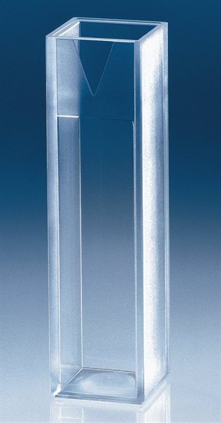
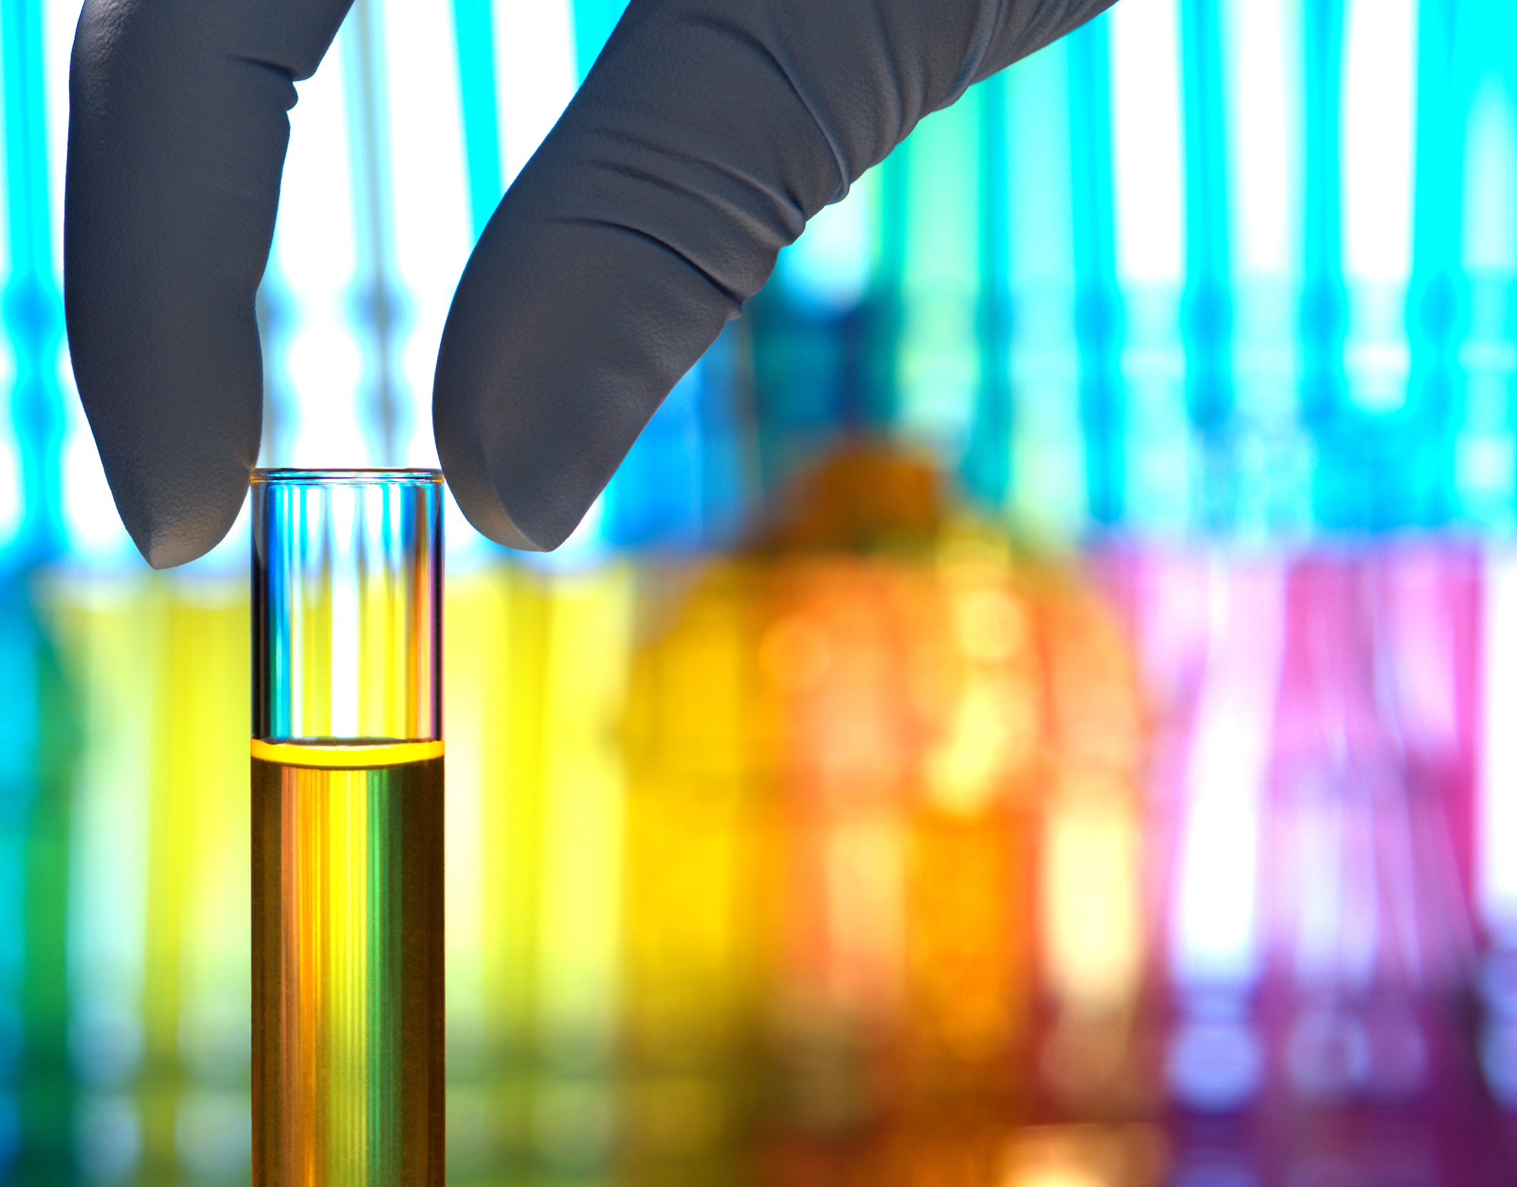
The experiment
S

Slide 18
Purpose of Project
Determine catalase activity in tissue samples
  Allowing us to ascertain differences and hypothesize what might account for these differences
  Calf liver, chicken liver, beef heart, beetroot, beetroot skin
Chose beef heart to compare to the calf liver
  Determine differences in catalase activity in different organs
Chose beetroot to compare with skin
  Compare differences between the beet skin and the inside of the beetroot
Comparing difference between plant and animal tissue
Triton X-100 as inhibitor

Slide 19
Laboratory Equipment
Spectrophotometer
  UV-vis
  Spec-20
Cuvettes
  Glass
  Plastic
Eppendorf Tubes
50 mL beaker
A

Slide 20
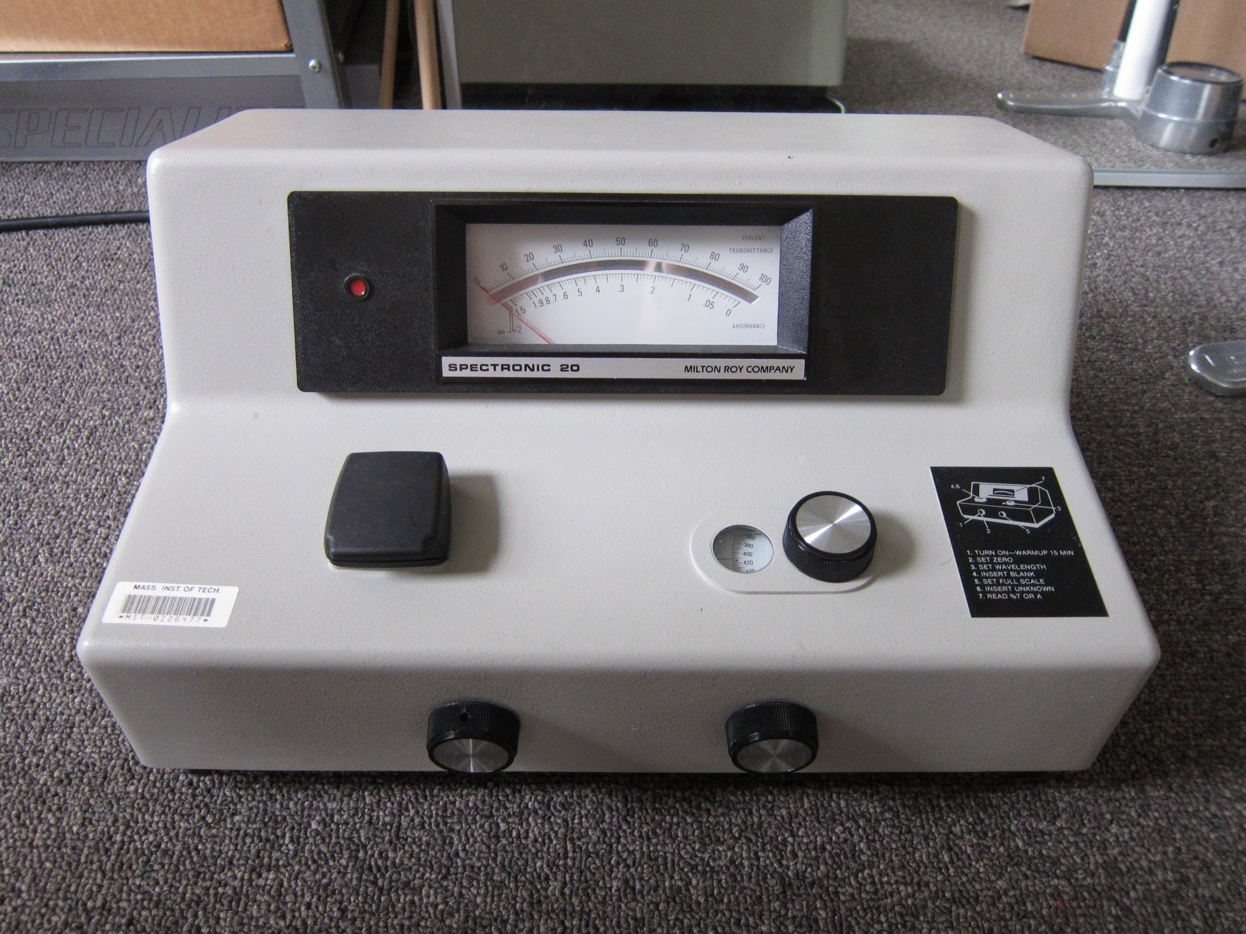
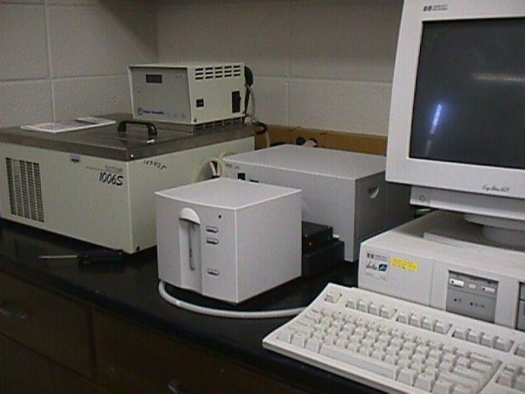
Spectrophotometers
Spec-20
  Designed to operate across the visible spectrum with a spectral bandwidth of 20 nm
UV vis
  Designed to operate with lights in the visible range and near UV and near infrared ranges
Notes:
The spectral bandwidth is defined as the width of the band of light at one-half the peak maximum (or full width at half maximum [FWHM])

Slide 21
Laboratory Chemicals
Hydrogen Peroxide
Horseradish Peroxidase
Catalase
Distilled water
Sodium Azide
Phosphate Buffer
A

Slide 22
Extract Preparation
Cut 1-2 gram sample of extract tissue and mass out on scale.
Mash in chilled mortar with pestle.
Measure out 10 ml PB to pour in the mortar
Get 4 eppendorf tubes and transfer 1.5 ml into each eppendorf tube using a plastic pipet
Put in the centrifuge for 10 minutes at 14,000 rpm to form pellets and supernatant.
Transfer supernatant to test tube and obtain Bradford absorbance.
Keep 2 pellets and store supernatant and pellets in fridge.

Slide 23
Steps for Protein Quantitation
After collecting supernatant into the test tube measure absorbance of sample
Choose Bradford line: y = 0.101x + 0.4122 or y= 0.0076x + 0.5217 depending on the absorbance range
Find the concentration of protein from the selected bradford line
  This is the protein in mg/ml. Multiply by total volume to find total protein

Slide 24

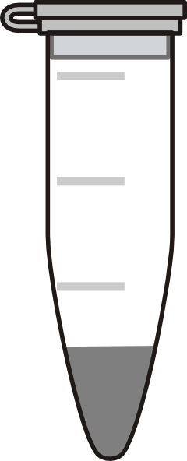
Catalase Assay: Dilutions
Set up two tubes with 380 μl of water in them and one tube with 480 μl.
Put 20 μl of tissue extract solution into first tube with 380 μl of water, mix. This is the 20X dilution.
Put 20 μl of 20X into second tube with 380 μl of water, mix. This is the 400X dilution
Put 20 μl of the 400X into tube with 480 μl of water, mix. This is the 10,000 solution.
Repeat for pure catalase to be used as a comparison.
380 μl H20
380 μl H20
480 μl H20
20 X
400 X
10000 X
20 μl
20 μl
20 μl

Slide 25
Catalase Assay: Reaction
20 X CE
400 X CE
10000 X CE
20 X C
400 X C
10000 X C
6 μl
6 μl
6 μl
6 μl
6 μl
6 μl
B1
B2
B3
20 X CE
400 X CE
10000 X CE
20 X C
400 X C
10000X C
225 μl H20
225 μl H20
225 μl H20
219 μl H20
219 μl H20
219 μl H20
219 μl H20
219 μl H20
219 μl H20
75 μl H202
75 μl H202
75 μl H202
75 μl H202
75 μl H202
75 μl H202
75 μl H202
75 μl H202
75 μl H202

Slide 26
Catalase Assay: Stop Solutions
B1
B2
B3
20 X CE
400 X CE
10000 X CE
20 X C
400 X C
10000X C
225 μl H20
225 μl H20
225 μl H20
219 μl H20
219 μl H20
219 μl H20
219 μl H20
219 μl H20
219 μl H20
75 μl H202
75 μl H202
75 μl H202
75 μl H202
75 μl H202
75 μl H202
75 μl H202
75 μl H202
75 μl H202
100 μl
B1
B2
B3
20 X CE
400 X CE
10000 X CE
20 X C
400 X C
10000X C
891 μl H20
891 μl H20
891 μl H20
891 μl H20
891 μl H20
891 μl H20
891 μl H20
891 μl H20
891 μl H20
9 μl NaN3
9 μl NaN3
9 μl NaN3
9 μl NaN3
9 μl NaN3
9 μl NaN3
9 μl NaN3
9 μl NaN3
9 μl NaN3

Slide 27
Catalase Assay: Color Reagent
B1
B2
B3
10000 X CE
10000 X C
100 μl
1 ml Color Reagent
B1
B2
B3
10000 X CE
10000 X CE
10000 X C
10000 X C

Slide 28
Calculations
In order to calculate average catalase activity we first obtain our absorbance values from the assay.
We use the standard curve y = 23.3x + 0.0433 to find the μmol of concentration of H202 in the sample
Activity = (x * 10,000 * 100)/ (0.3 * time). Variations exist in the absorbance and time reacted.
For catalase we divide by its concentration (mg/ml)
For extract we find the concentration first through protein quantification then divide activity by that value.

Slide 29
Inhibitor Assay: Dilutions
Dilutions for the inhibitor are the same as the ones for the catalase assay
20 μl of pure catalase goes into the 20X solution, 20 μl of that goes into the 400X solution and 20 μl of that goes into the 10,000X solution.
Only the 10,000X solution is used to keep the concentration of catalase constant while we test the effects of the inhibitors.
380 μl H20
380 μl H20
480 μl H20
Catalase
20 X
400 X
10000 X
20 μl
20 μl
20 μl

Slide 30
Inhibitor Assay: Reaction
10000 X C
6 μl
225 μl H20
75 μl H202
B1
B2
B3
10000 C
10000 C
x% Triton X
x% Triton X
w% Triton X
w% Triton
X
y μl Triton X
z μl h20
75 μl H202
219 μl H20
75 μl H202

Slide 31
Inhibitor Assay: Stop Solutions
B1
B2
B3
10000 C
10000 C
x% Triton X
x% Triton X
w% Triton X
w% Triton
X
100 μl
B1
B2
B3
10000 C
10000C
x% Triton X
x% Triton X
w% Triton X
w% Triton
X
891 μl H20
891 μl H20
891 μl H20
891 μl H20
891 μl H20
891 μl H20
891 μl H20
891 μl H20
891 μl H20
9 μl NaN3
9 μl NaN3
9 μl NaN3
9 μl NaN3
9 μl NaN3
9 μl NaN3
9 μl NaN3
9 μl NaN3
9 μl NaN3

Slide 32
Inhibitor Assay: Color Reagent
B1
B2
B3
10000 C
10000C
x% Triton X
x% Triton X
w% Triton X
w% Triton
X
100 μl
1 ml Color Reagent
B1
B2
B3
10000 C
10000 C
x% Triton X
x% Triton X
w% Triton X
w% Triton X

Slide 33
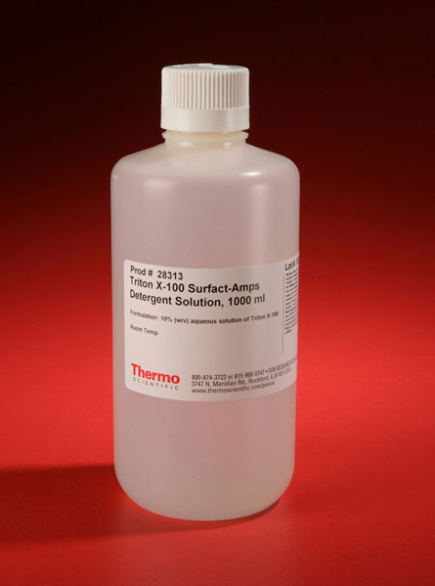
Triton X-100
Mild detergent
Non-ionic surfactant and emulsifier
  Biochemical applications
Soluble in water
Viscous colorless liquid
  Hydrogen bonding (of hydrophilic polyethylene oxides)
Notes:
Biochemical applications to solubilize proteins, without denaturing them (taking apart their structure).
Non-ionic surfactant: Long chain alcohol. Surfactants are compounds that lower the surface tension between two liquids or between a liquid and a solid. Surfactants may act as detergents, wetting agents, emulsifiers, foaming agents, and dispersants
Emulsifiers and emulsifying particles tend to promote dispersion of the phase in which they do not dissolve very well.

Slide 34
3.93%
Percent of Triton X-100 in our experiment.

Slide 35
Inhibitor Assay: Calculations
Calculations are similar to the calculations in the catalase assay
  Except, no protein quantification needed
  All calculations are made using steps 1 through 5
Graph: Absorbance (520 nm) by concentration of Triton X-100

Slide 36
Inhibitor Assay: Calculations
To find volume of inhibitor needed, set-up dilution equation
  (300 microliters)(% solution desired)=(3.93%)(x microliters needed to add)
For example, to obtain:
  0.1% solution = 7.63λ Triton X-100
  0.6% solution = 45.8λ Triton X-100

Slide 37
Results
R

Slide 38
Measurements
Total volume of extract
Total protein in extract
Activity
Total Activity
Specific Activity
Activity/Protein
Activity/Wet mass
Data in following table
R
Notes:
Total volume of typical extract: Average value for each extract
Total protein in extract: Protein (mg/mL) times total volume
Activity: Catalase activity per reaction
Total Activity: Volume of extract used to set up reaction multiplied by the total volume of extract
Specific Activity: μmol H₂O₂/min
Activity/Protein: Volume of extract used to set up reaction multiplied by the total volume of extract and divided by total protein
Activity/Wet Mass of Tissue: Volume of extract used to set up reaction multiplied by the total volume of extract and divided by wet mass of tissue

Slide 39
Total Volume of Extract (mL)
Four eppendorf tubes
  1.5 mL per tube
Supernatant only
  Calculation excludes pellet
Allows us to calculate amount of protein in tube

Slide 40



Total Protein in Extract (mg)
Refers to total concentration of protein collected
Found through Bradford assay calculations
  Absorbance of supernatant
  Gives us milligrams per milliliter
Multiplied by total volume

Slide 41


Catalase Activity
Quantifies amount of hydrogen peroxide degraded
  Does not take into account amount of protein
  Does not take into account total volume of extract used

Slide 42
Total Catalase Activity
Quantifies amount of hydrogen peroxide degraded
  Accounts for total volume of extract
  Within a 300 microliter reaction

Slide 43
Specific Catalase Activity
Quantifies amount of hydrogen peroxide degraded
  Accounts for concentration of protein
  Within a 300 microliter reaction

Slide 44
Catalase Activity in a Tissue Sample
Quantifies amount of hydrogen peroxide degraded
  Accounts for total concentration of protein in supernatant collected
  Within the entire supernatant (5 mL)

Slide 45
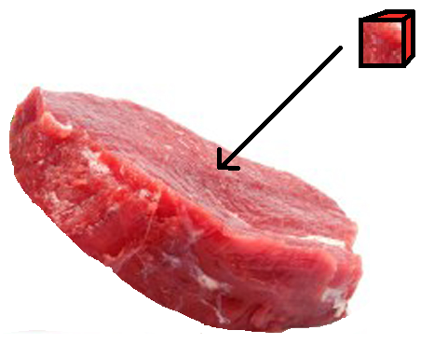
Catalase Activity per Wet Mass of Tissue
Quantifies amount of hydrogen peroxide degraded
  Accounts for total volume of extract
  Within the tissue cube (approx. 1.2 g)
    Wet mass evaluation

Slide 46
Data Collections
Tissue | Average Volume (mL) | Protein in Extract (mg) | Average Activity (units) | Total Activity (units* mL) | Specific Activity (units/ mg) | Total Activity/ Total Protein (units*mL/ mg) | Total Activity/ Wet mass tissue (units*mL/g)
Chicken Liver | 5 | 10.22 | 4494.76 | 22473.8 | 439.80 | 2199.00 | 18728.17
Calf Liver | 5 | 7.39 | 2779.53 | 13897.6 | 376.12 | 1880.60 | 12634.23
Beetroot Skin | 5 | 9.75 | 2538.12 | 12690.6 | 260.32 | 1301.60 | 10575.50
Beetroot | 5 | 18.88 | 2337.72 | 11688.6 | 123.82 | 619.10 | 9740.50
Beef Heart | 5 | 19.63 | 2235.66 | 11178.3 | 113.89 | 569.45 | 9315.25
R

Slide 47
Chicken Liver Tissue Results
Pure Catalase | Chicken Liver
9382.96 | 425.184876
8739.02 | 453.470687
6282.94 | 440.759
Average Bradford: 0.95788
Average Pure Catalase
8134.973333
Average Chicken Liver Catalase
439.8048543
Ratio (Pure Cat.: Chicken Cat.)
18.49677932

Slide 48
Calf Liver Tissue Results
Pure Catalase | Calf Liver
4643.33 | 420.827
4113.33 | 454.892
2282.67 | 252.655
Average Bradford: 0.6937
Average Pure Catalase
3679.776667
Average Calf Liver Cat.
376.1246667
Ratio (Pure Cat.: Calf Cat.)
9.783396285

Slide 49
Beetroot Skin Tissue Results
Pure Catalase | Beetroot Skin
9798.48 | 420.88
7239.35 | 299.44
1703.03 | 60.64
Average Bradford: 0.64824
Average Pure Catalase
6246.95
Average BR Skin Catalase
260.32
Ratio (Pure Cat.: BR Skin Cat.)
23.997

Slide 50
Beetroot Tissue Results
Pure Catalase | Beetroot
1212.35 | 85.1579
1556.17 | 93.9278
2181.17 | 192.363
Average Bradford: 0.68802
Average Pure Catalase
1649.896667
Average Beetroot Catalase
123.8162333
Ratio (Pure Cat.: BR Cat.)
13.32536633

Slide 51
Beef Heart Tissue Results
Pure Catalase | Beef Heart
1129 | 76.8
973.5 | 122.5
1703.11818 | 142.372
Average Bradford: 0.55712
Average Pure Catalase
1268.539393
Average Beef Heart Catalase
113.8906667
Ratio (Pure Cat.: Calf Cat.)
11.13822081

Slide 52
Data Collections
Tissue | Average Volume (mL) | Protein in Extract (mg) | Average Activity (units) | Total Activity (units* mL) | Specific Activity (units/ mg) | Total Activity/ Total Protein (units*mL/ mg) | Total Activity/ Wet mass tissue (units*mL/g)
Chicken Liver | 5 | 10.22 | 4494.76 | 22473.8 | 439.80 | 2199.00 | 18728.17
Calf Liver | 5 | 7.39 | 2779.53 | 13897.6 | 376.12 | 1880.60 | 12634.23
Beetroot Skin | 5 | 9.75 | 2538.12 | 12690.6 | 260.32 | 1301.60 | 10575.50
Beetroot | 5 | 18.88 | 2337.72 | 11688.6 | 123.82 | 619.10 | 9740.50
Beef Heart | 5 | 19.63 | 2235.66 | 11178.3 | 113.89 | 569.45 | 9315.25

Slide 53
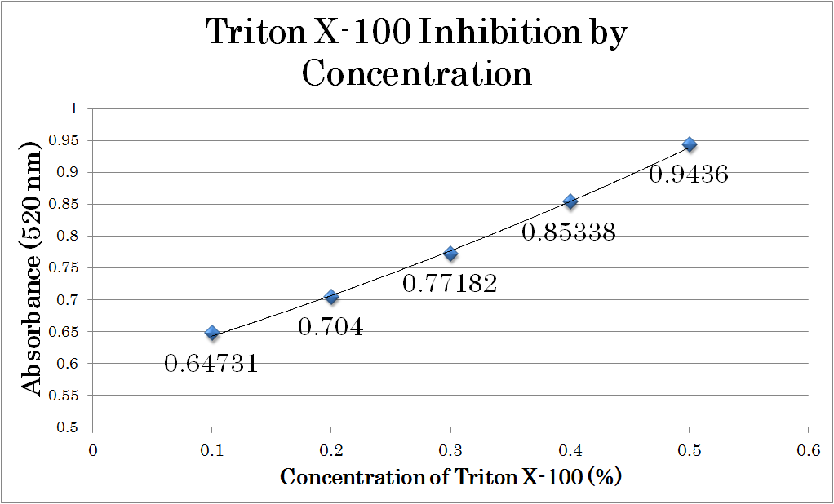

Slide 54
Conclusion
K

Slide 55
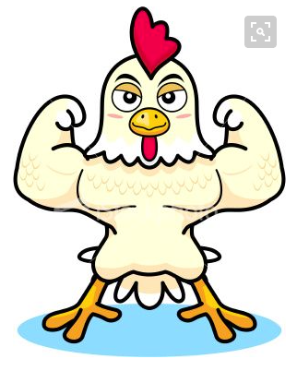
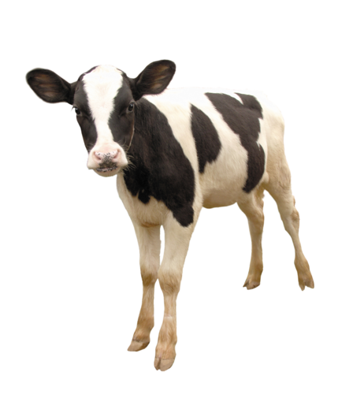
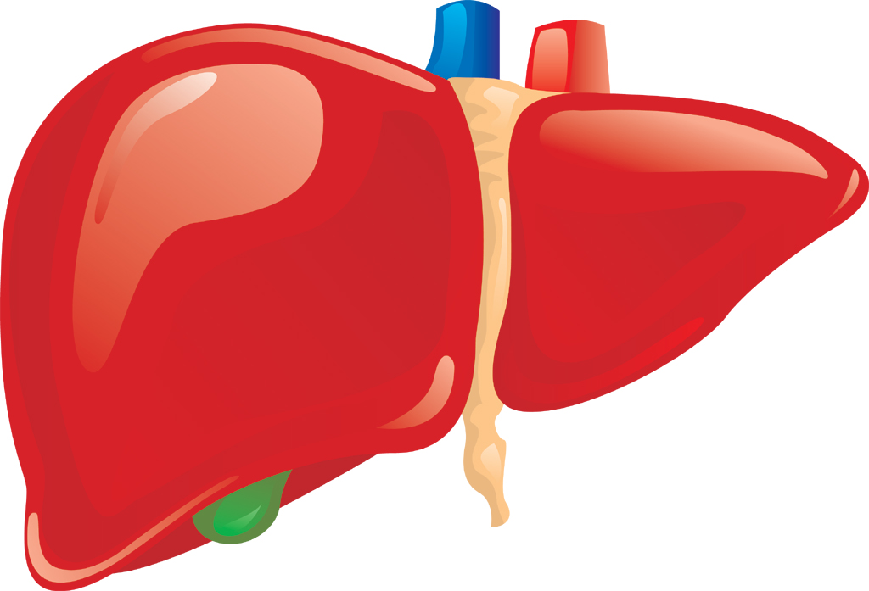
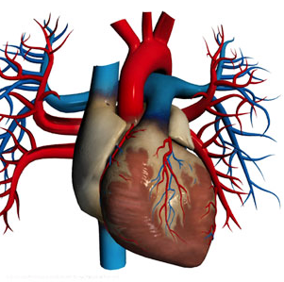
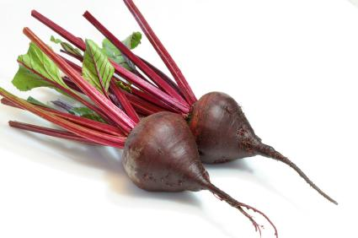
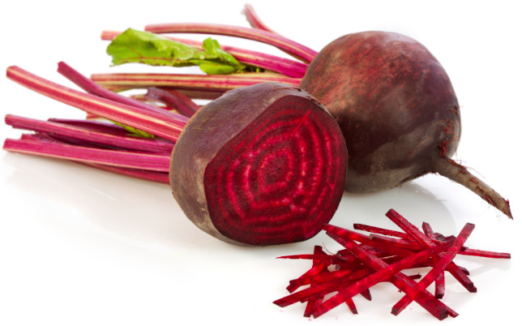
CALF LIVER VS. CHICKEN LIVER
CALF LIVER VS. BEEF HEART
BEETROOT VS. BEEF HEART
BEETROOT FLESH VS. BEETROOT SKIN
Notes:
beetroot has nitrates that widen blood vessels which allow more oxygen

Slide 56
TRITON X-100

Slide 57


Sources of Error
Contamination
  Equipment not clean
  Not a sterile environment
Inconsistency
  Refrigeration
  Pipetting
  Temperature/pH
Notes:
didnt refrigerate right away
PB not squeaky clean

Slide 58
Acknowledgements

Slide 59
References
http://www.ncbi.nlm.nih.gov/pmc/articles/PMC3812649/
http://onlinelibrary.wiley.com/doi/10.1111/j.1469-8137.1931.tb07427.x/pdf
http://www.pnas.org/content/81/14/4343.full.pdf
http://dx.doi.org/10.1080/03758397.1955.10857289
https://wfs-biologysl2.wikispaces.com/file/view/Sample+Bio+Liver+Lab.pdf
Sigma-Aldrich paper about Bradford Reagent
http://www.ncbi.nlm.nih.gov/pubmed/26457670

Slide 60
References
https://theeugenehughesblog.files.wordpress.com/2012/09/fotolia_test-tube.jpeg
http://www.sigmaaldrich.com/catalog/product/sigma/t8787?lang=en&region=US
http://www.sciencedirect.com/science/article/pii/S0014579300021979
http://katalase.blogspot.com/
http://gutenberg.us/articles/catalase
http://www.worthington-biochem.com/ctl/default.html
http://earth.callutheran.edu/Academic_Programs/Departments/BioDev/omm/catalase/frames/cattx.htm

Slide 61
References
http://www.madsci.org/posts/archives/2000-06/961627236.Bc.r.html
http://jhc.sagepub.com/content/48/5/585.full.pdf
http://www.biology-online.org/biology-forum/about6308.html
http://www.berkeleywellness.com/healthy-eating/nutrition/slideshow/fruit-vegetable-peel-perks
http://undergroundhealthreporter.com/vegetables-for-cancer-beetroot/#axzz3ymwMDSbberepository.cu.edu.eg/index.php/MJCU/article/view/1109/1083

Slide 62
Questions?

Slide 63
Data Collections
Tissue | Average Volume (mL) | Protein in Extract (mg) | Average Activity (units) | Total Activity (units* mL) | Specific Activity (units/ mg) | Total Activity/ Total Protein (units*mL/ mg) | Total Activity/ Wet mass tissue (units*mL/g)
Chicken Liver | 5 | 10.22 | 4494.76 | 22473.8 | 439.80 | 2199.00 | 18728.17
Calf Liver | 5 | 7.39 | 2779.53 | 13897.6 | 376.12 | 1880.60 | 12634.23
Beetroot Skin | 5 | 9.75 | 2538.12 | 12690.6 | 260.32 | 1301.60 | 10575.50
Beetroot | 5 | 18.88 | 2337.72 | 11688.6 | 123.82 | 619.10 | 9740.50
Beef Heart | 5 | 19.63 | 2235.66 | 11178.3 | 113.89 | 569.45 | 9315.25

Slide 64
Happy Birthday Afra!

